Slide 1
Ethylene Tetramerization: Mechanism and Role of Solvent
Sibo Lin, Yagnaseni Ghosh, Brian Hanna, dana wong, Mohamed Elanany, Motaz Khawaji, Wei Xu

Slide 2
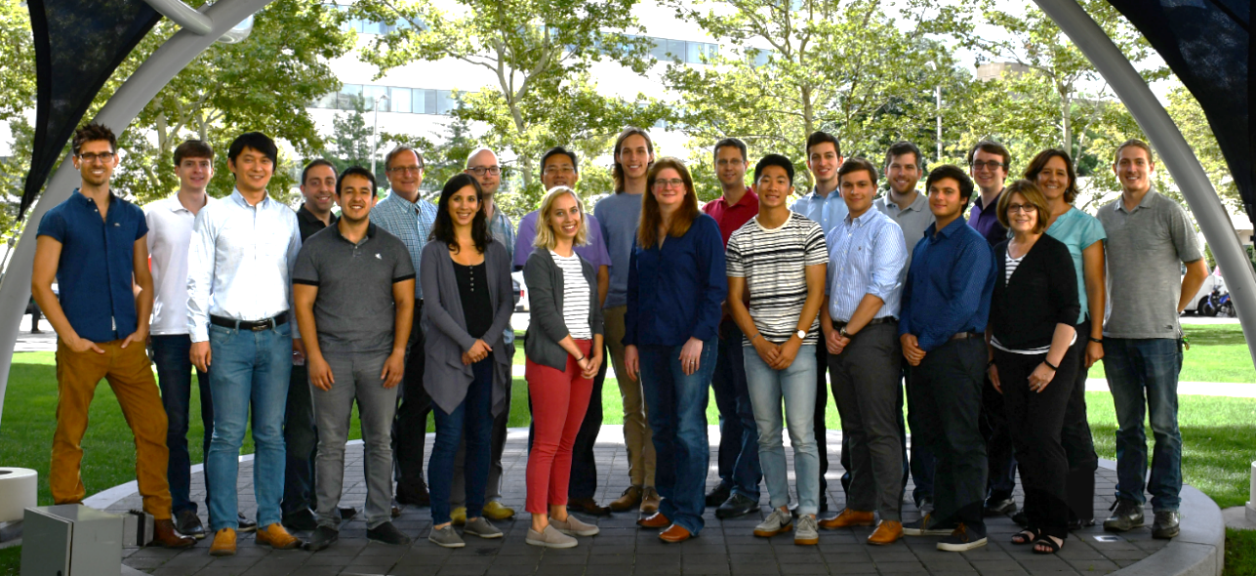
acknowledgements
Aramco Americas
Advanced Materials Team (Cambridge, MA)
Jenna C. Fromer
Yagnaseni Ghosh
Brian Hanna
Douglas Theberge
Dana A. Wong
Atieh Abu Raqabah
Saudi Aramco Chemicals R&D
Mohamed Elanany
Wei Xu
Motaz Khawaji
King Fahd Univ. of Petroleum and Minerals
E. A. Jaseer
Samir Barman

Slide 3


Boston downstream research center
mission: accelerate downstream innovations through development and optimization of advanced materials

Slide 4
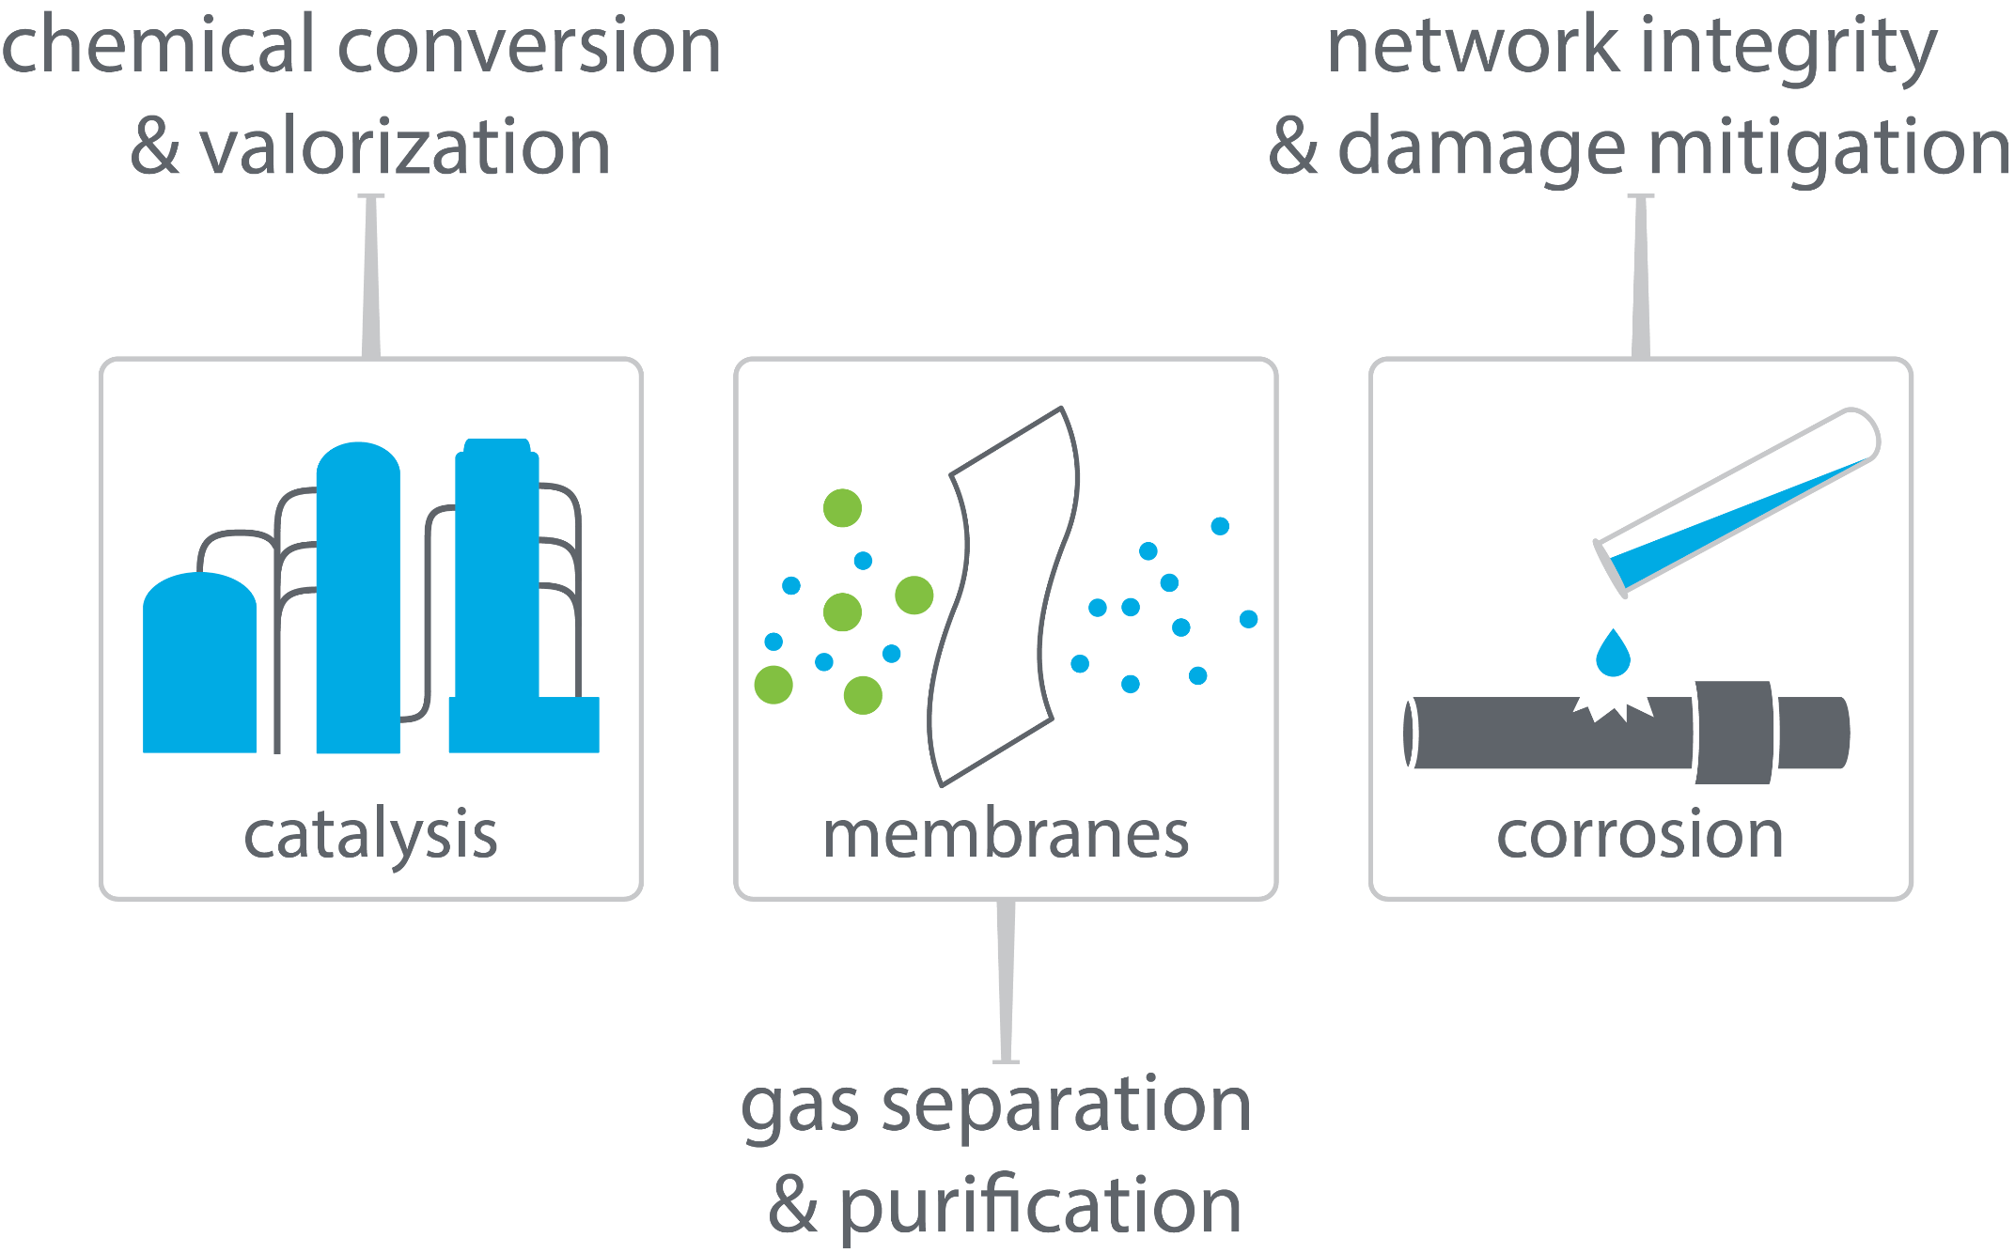
boston downstream research center

Slide 5

linear α-olefins for LLDPE
polyethylene plant
LLDPE
1-butene
ethylene
1-hexene
1-butene
1-hexene
polymer quality increases
1-octene
1-octene
highest quality plastic

Slide 6
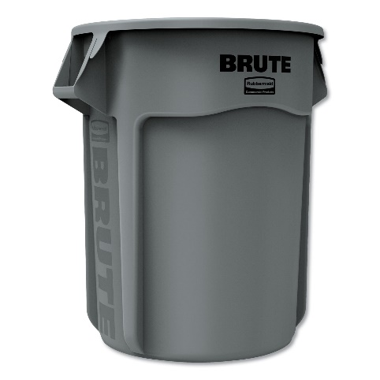
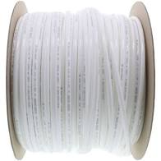
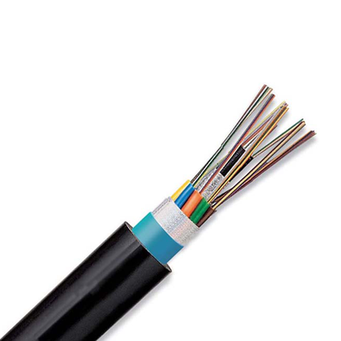
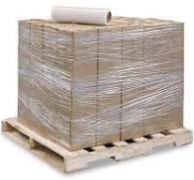
LLDPE
tough
flexible and food-safe
1-butene
stretchable
electrical and chemical safety
1-hexene
1-octene
Notes:
Image credits:
https://www.uline.com/Product/Detail/S-12827/Uline-Stretch-Wrap/Economy-Stretch-Wrap-Cast-80-gauge-18-x-1500
https://www.freshwatersystems.com/products/3-8-od-lldpe-polyethylene-tubing-500-ft-roll
https://www.hillnmarkes.com/
http://www.blspolymers.com/LLDPE.htm

Slide 7
full range α-olefins processes
How to make 1-octene selectively?
undesired products
1-butene
1-hexene
existing commercialized full range technologies:
Shell Higher Olefin Process (SHOP)
Chevron Phillips full-range process
INEOS process
1-octene
Nexant report - Developments in LAO Comonomer for Polyethylene - PERP 2012S11

Slide 8

two strategies for more 1-octene
confining full-range catalysts
selective ethylene tetramerization
modify a full-range catalyst to skew the product distribution
Nexant report - Developments in LAO Comonomer for Polyethylene - PERP 2012S11

Slide 9
selective ethylene tetramerization
Sasol’s catalyst
Activity (kg/g Cr/h) | 1-C₈ (wt%) | 1-C₆ (wt%) | PE (wt%)
272.4 | 67 | 12 | 1
Bollman et al, J. Am. Chem. Soc. 2004, 126, 14712
Confidential

Slide 10
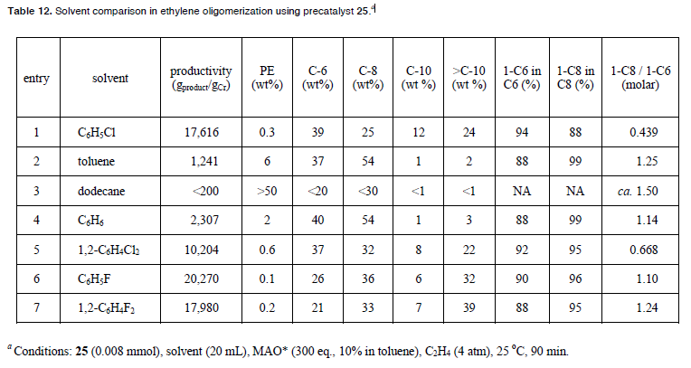
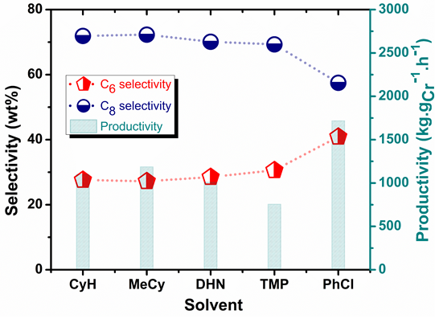
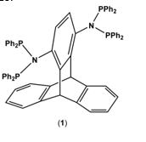
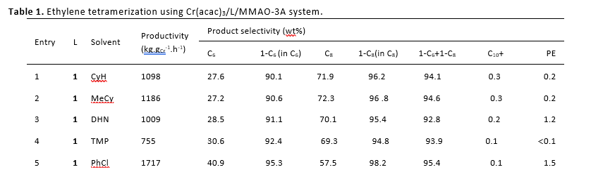
empirical effect of PhX on ethylene oligomerization
Results with a Cr-PNP catalyst being developed at KFUPM (Samir Barman and E. A. Jaseer)
Paul R. Elowe, Caltech Ph.D. Thesis, 2008
PhX solvent increase catalyst productivity
PhX lowers PEwt% relative to PhMe and PhH
PhCl lowers C8/C6 ratio
PhF preserves C8/C6 ratio
Elowe, P. R.; Bercaw, J. E. "Solvent, additive and co-catalyst effects for ethylene oligomerization catalysis." 2009, WIPO, WO2009046144A1.

Slide 11
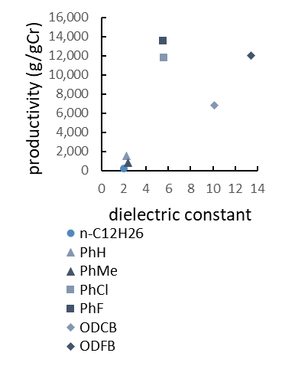
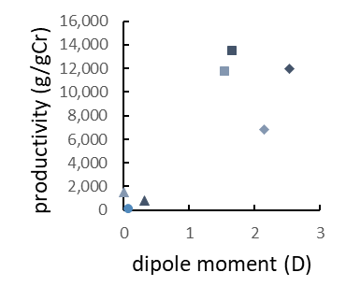
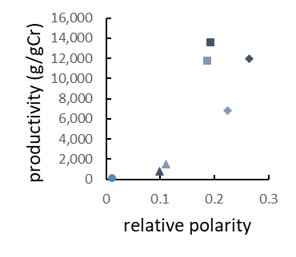
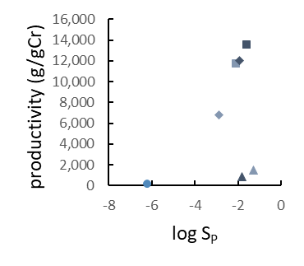
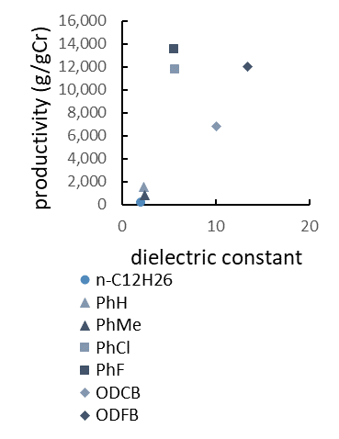
Correlation between solvent polarity vs activity
(a)
(b)
Dielectric constant, dipole moment, and relative polarity do not explain underperformance of ortho-dihaloarene solvents
log S_{P} does not explain underperformance of unhalogenated arenes
(c)
(d)

Slide 12
McGuinness’s 2016 DFT mechanism study
Model of truncated ligand predicts (too) high 1-octene/1-hexene ratio (ΔΔG = 5.7 kcal/mol)
7 conformers of 18b were considered
1 conformer of TS18f-19 was considered
Many more were not explicitly modelled
Replacing N-Me with N-iPr: ~3x # of conformers

Slide 13
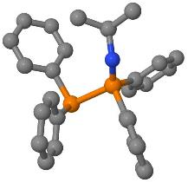
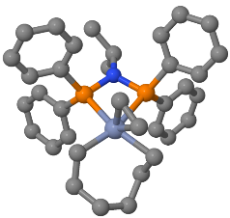
Computational: Automated Conformational Analysis (XTBDFT)
autoConf
Automated multi-level conformational search
Built on 3 open-source engines:
GFN-xTB/CREST
NWChem
GoodVibes
Simplified user input
Lightweight (for facile installation on internet-restricted compute clusters)
input geometry
(and charge and spin)
final structure and energy
XTBDFT
single-ended reaction coordinate scan
(GFN-xTB)
conformer ensemble generation & ranking
(CREST and GFN-xTB)
ensemble refinement (NWChem)
minimum final optimization (NWChem)
quasi-harmonic frequency corrections
(Goodvibes)
input reactant geometry
specify reaction coordinate
(and charge and spin)
final TS structure and energy
46 unique conformers in 6 kcal/mol window
autoTS
Lin, S. SoftwareX 2021, in preparation

Slide 14
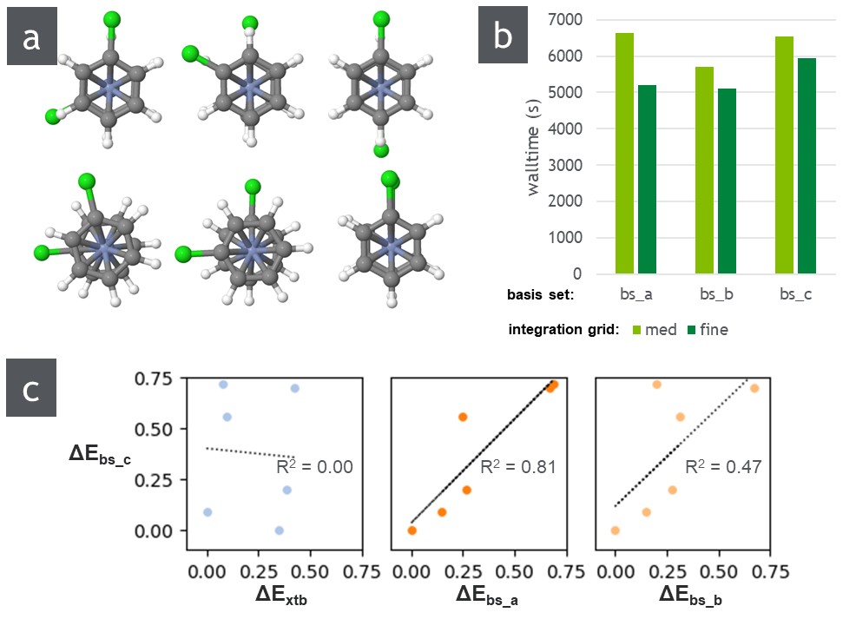
benchmarking DFT parameters for Cr complexes
Use fine integration grid (faster and more accurate)
Basis sets:
bs_a = def2-SV(P) all atoms
bs_b = def2-SVP on Cr; def2-SV(P) all other atoms
bs_c = def2-SVP all atoms ← most accurate, moderate increase in calculation time

Slide 15
Haloarene solvents limits formation of inactive [Cr(arene)₂]+
Electron-poor aromatic solvents are proposed to enhance catalysis by limiting formation of inert [Cr(arene)]⁺
Bercaw and coworkers, ACS Catal. 2013, 3, 2582
w/ Al
DFT calculated reaction energies
X = | H | Cl | F
ΔG (w/ Al) | 0.5 | 9.4 | 11.0
ΔG (no Al) | tbd | tbd | tbd
no Al

Slide 16
reaction pathway for full Sasol ligand, no additives
toward
1-hexene product
toward
C₁₀₊ products
turnover-limiting barriers
product-determining barriers
ΔΔG(1-hexene/1-octene) = 3.1 – 0.6 = 2.5
ΔΔG(1-octene/C₁₀₊) = -5.1 – 2.3 = -7.4
toward
1-octene product
Computational details: NWChem 6.8, M06-D3/def2-TZVP//B3LYP-D3/def2-SVP + solvation energy (M06-D3/def2-SVP)

Slide 17
effect of additives on turnover-limiting step
third ethylene ligand does NOT assist the rate determining step
halobenzene solvents do not assist in rate-determining barrier
(unless a different TS geometry can be found)
Greater catalyst activity in PhX solvent may be due to greater proportion of solubilized cationic catalyst, or some action on the MMAO co-catalyst
Computational details: NWChem 6.8, M06-D3/def2-TZVP//B3LYP-D3/def2-SVP + solvation energy (M06-D3/def2-SVP)

Slide 18
effect of PhX on 1-C6/1-C8 selectivity
ΔG in kcal/mol, including continuum solvent corrections
w/o explicit PhX
explicit PhCl solvent:
explicit PhF solvent:
DFT model correctly predicts loss of 1-octene/1-hexene selectivity with PhCl solvent
DFT model correctly predicts retention of 1-octene/1-hexene selectivity with PhF solvent
DFT supports that haloarene solvents can act as chain-terminating agents, which lead to the lower observed polyethylene wt%
ΔΔG: 1.4 0.2 1.4
Computational details: NWChem 6.8, M06-D3/def2-TZVP//B3LYP-D3/def2-SVP + solvation energy (M06-D3/def2-SVP)

Slide 19
reaction pathways with PhX solvents
L =
(PhCl)
(PhF)
(none)
L =
(PhF)
(PhCl)
(none)
(PhF)
(C₂H₄)
(PhCl)
(none)
toward
1-hexene
L =
(PhF)
(C₂H₄)
(PhCl)
(none)
toward C₁₀₊
toward C₈₊
Still need to model
Barrier toward cyclic C6 products
Other secondary ligands (o-dihalobenzene)
Other ligands (N-(m-CF₃-C₆H₄) for KFUPM?)
toward
1-octene
Computational details: NWChem 6.8, M06-D3/def2-TZVP//B3LYP-D3/def2-SVP + solvation energy (M06-D3/def2-SVP)

